Slide 1
IPv6 Security
Tirthankar Ghosh

Slide 2
History
IPv6 was standardized at the end of 1998 in RFC 2460.

Slide 3
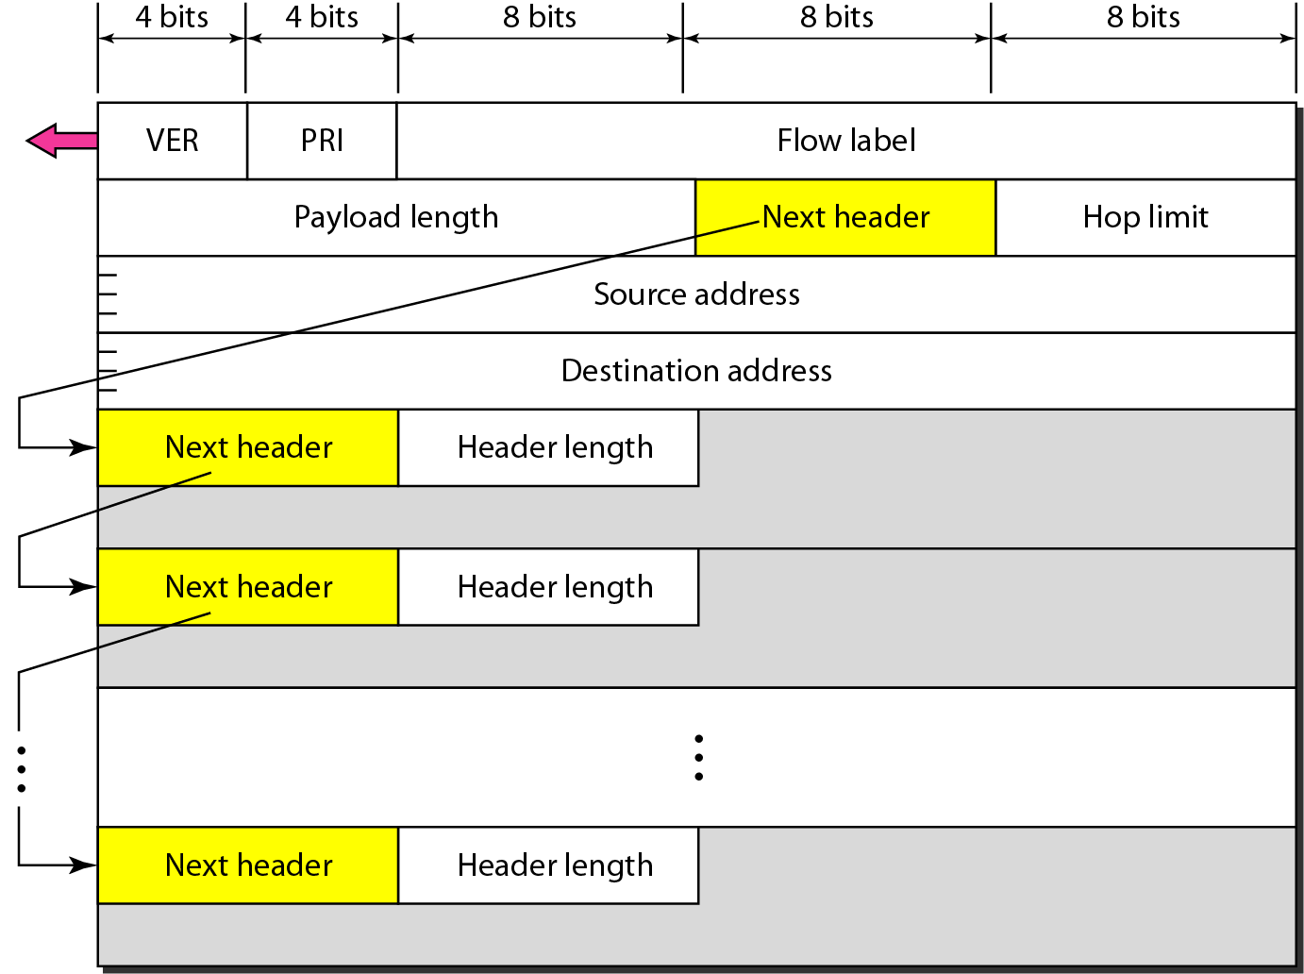
IPv6 Header

Slide 4
Header (cont’d)
Priority – signifies the priority of Internet traffic
Payload length – number of octets in the datagram excluding the header
Flow label – signifies a specific type of flow (ex. Delay and bandwidth specification for video traffic)
Next header – points to the extension header (if any). Extension headers are used only when the particular service is used (ex. Fragmentation header)
Hop Limit – same as TTL in IPv4

Slide 5
Next Header Codes

Slide 6
Priorities for congestion-controlled traffic

Slide 7
Priorities for noncongestion-controlled traffic

Slide 8
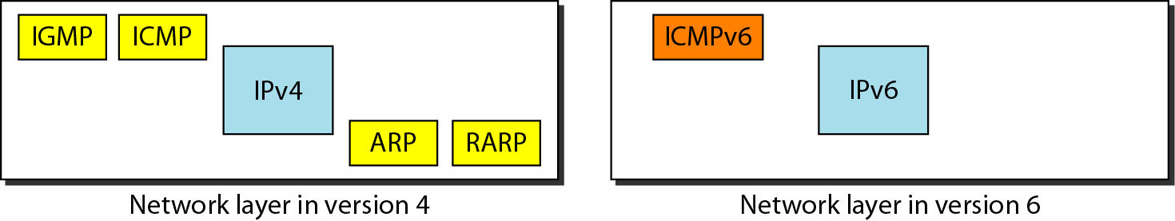
ICMPv6

Slide 9
Comparison of error-reporting messages in ICMPv4 and ICMPv6

Slide 10
Comparison of query messages in ICMPv4 and ICMPv6

Slide 11
ICMPv6 Attacks
Simple spoofing
Attack on network infrastructure
Denial of Service
Read RFC 4890: Recommendations for Filtering ICMPv6 Messages in Firewalls

Slide 12
Countermeasures
One solution is to simply block all ICMPv6 error message types that have not been allocated by IANA.
Unallocated error message (5-99, 102-126)
Unallocated information message (155-199, 202-254)
Experimental messages (100, 101, 200, 201)
Extension type numbers (127, 255)

Slide 13
Countermeasures (cont’d)
Block ICMPv6 messages from outside other than that are not needed. Specifically following should be allowed:
Destination unreachable (1)
Packet too big (2)
Time exceeded (3)
Parameter problem (4)

Slide 14
Specific Packets to Block
Router readdressing (Type 138) – RFC 2894
Node information query messages (Types 139, 140)

Slide 15
Limiting DoS
Limit ICMPv6 error messages generated by the router by using ipv6 icmp error-interval <milliseconds> command.

Slide 16
IPv6 Extension Header
Defined in RFC 2460, and needs to be processed in a specific order:
IPv6 header
Hop-by-hop options header
Destination options header
Routing header
Fragmentation header
Authentication header
Encapsulating security payload header
Upper layer header

Slide 17
Extension Header Vulnerabilities
Attacker can perform header manipulation on extension headers.
Can be crafted in such a way to deny service to destination.
Lengthy headers can crash destination hosts.
Firewall evasion in case of crafted headers.

Slide 18
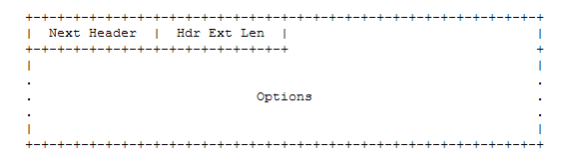
Hop-by-Hop and Destination Options Headers
Must be inspected by every node along the packet’s path.
The Options has 1-byte Option Type field, the first two bits of which determine how the nodes will treat the packet.
00 – skip option
01 – discard packet
10 – discard packet but send ICMPv6 parameter problem to source
11 - discard packet but send ICMPv6 parameter problem to source (only if destination is not multicast)

Slide 19
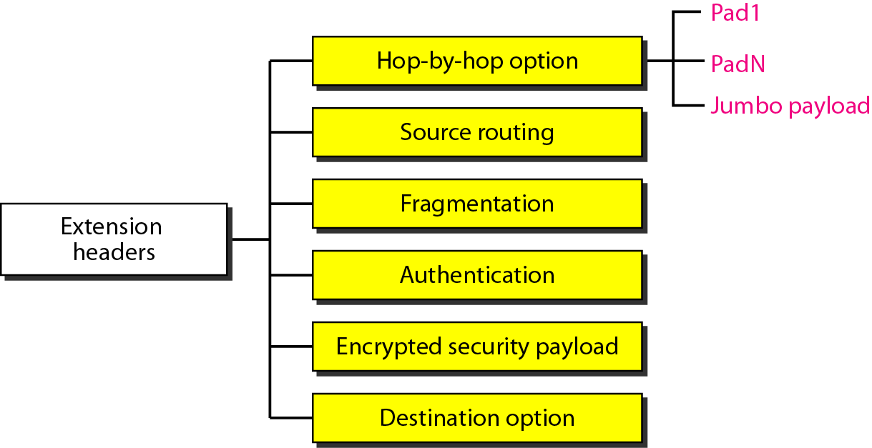
Hop-by-Hop and Destination Options Headers (cont’d)
The third bit of the Option Type tells the node whether the option changes on each hop:
1 : changes
0: does not change

Slide 20
Hop-by-Hop and Destination Options Headers Vulnerabilities
PadN options are required to have a 0-byte payload; so any information in these fields is either malicious or in error.
Firewalls should be designed to check that no data is carried in PadN options headers, and that data within the padding is not part of some type of attack.

Slide 21
Hop-by-Hop and Destination Options Headers Vulnerabilities (cont’d)
Router alert option within the Hop-by-Hop Options header is also a threat if used with malicious intent.
Presence of this option requires a router to inspect contents of the packet heard, thus draining the router of resources if large number of packets are sent with this option.

Slide 22
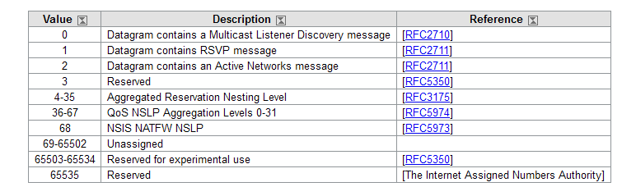
IANA Allocation of Router Alert Options Values
IPv6 Router Alert Option Values

Slide 23
Routing Headers
RFC 2460 states that all hosts must be able to handle routing headers.
Currently two types defined: Type 0 (RH0),and Type 2 (RH2).
RH0 is similar to source routing in IPv4.
RH2 is used with mobile IP.

Slide 24
Routing Header Vulnerabilities
Routing headers can be used to reflect traffic off intermediate nodes before reaching the destination.
Can be used to launch man-in-the-middle attack.
Can be used to evade firewalls as they cannot check for policy/rules based on address filtering.
IETF decided to deprecate use of RH0 (RFC 5095).

Slide 25
Preventing RH0 Attacks
Source routing options can be disabled in IPv4 routers using the following command:
no ip source-route
Following command blocks all Type 0 and Type 2 routing headers in IPv6 routers:
no ipv6 source-route

Slide 26
Fragmentation Headers
Upper layer information might not be contained within the first fragment.
Firewalls must be designed to look at multiple fragments to match a policy/rule.
Tiny fragment attack.
Reassembly policy for overlapping and duplicate fragments.
In IPv6, fragmentation is never performed by intermediate nodes.

Slide 27
Virtual Fragment Reassembly (VFR) in Cisco Routers
When a router sees packets with type 44 Fragment Header, it switches to fragmentation inspection mode.
It allows routers to reassemble fragments, examine out-of-order fragments, and puts them back into proper sequence.
It then examines fragments from a single source, and passes the final reassembled fragment to the stack.

